Slide 1

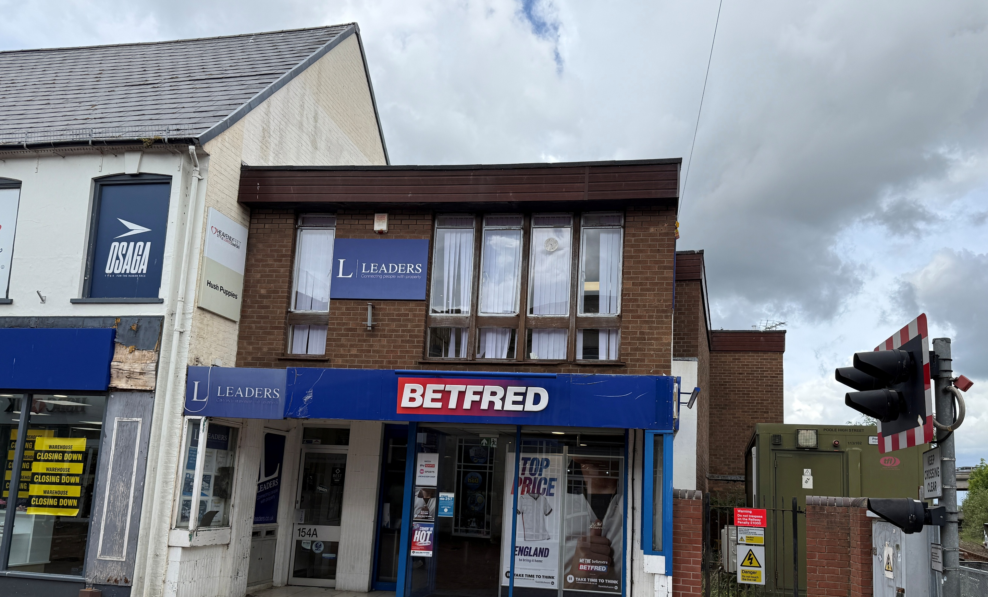

Suite 27 Briggs House
26 Commercial Road
Poole, BH14 0JR
Tel: 01202 673131
Email: properties@jamesandsons.co.uk
TO LET
FIRST FLOOR OFFICES TO LET– POOLE
1172 SQ FT (108.8 Sq M) APPROX.
154A HIGH STREET, POOLE, BH15 1DN

Slide 2
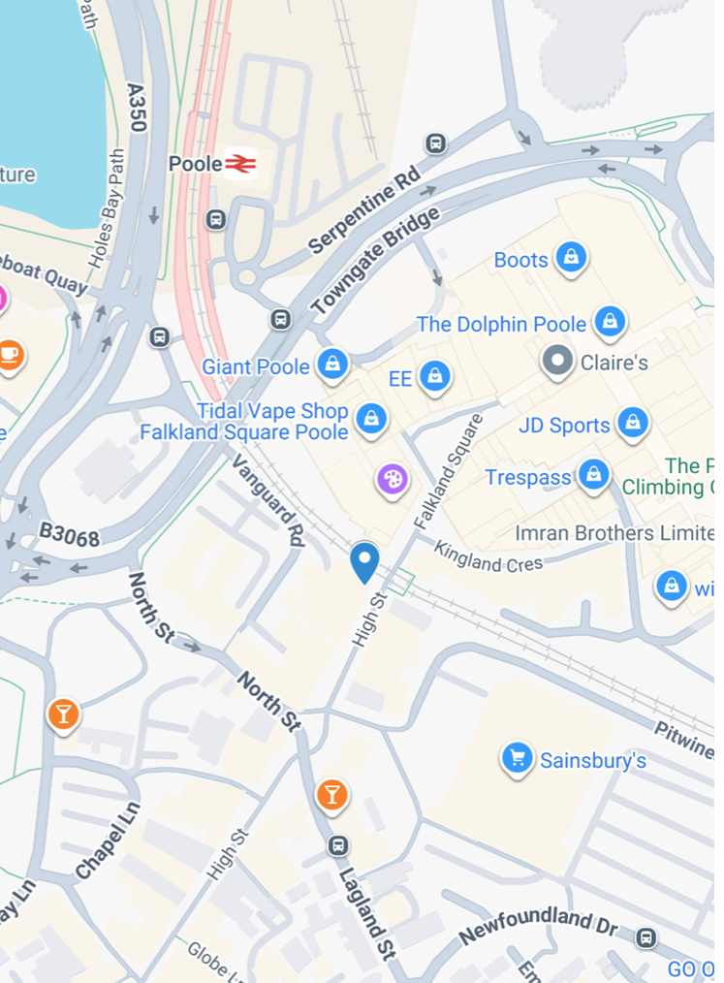
LOCATION
The premises occupy a prominent position on Poole High Street, at the heart of the town’s busy shopping district. The unit sits immediately beside Poole level railway crossing barriers, which closes several times each hour, naturally drawing regular pedestrian build‑up and enhancing visibility and prominance.
Over the crossing, only a short walk away, is the Dolphin Shopping Centre, the town’s principal retail destination. The immediate surrounding area is home to a strong mix of national retailers, including HSBC, Superdrug and Card Factory, ensuring consistent footfall throughout the day.
DESCRIPTION
The property comprises a first‑floor office unit with Ground Floor display cabinet and signage. Internally, the accommodation comprises an open plan front office area, leading through to a rear office space with a kitchenette and side office. There are separate ladies and gents Cloakroom/WCs.
There are four self-contained allocated parking spaces to a rear car park, accessed via Vanguard Road and both front and rear pedestrian access to the offices.
ACCOMMODATION
The accommodation comprises the following approximate areas :
Net Internal Area:
Office 1131 sq ft q ft (105.1 sq m)
Separate Ladies and Gents Cloakrooms/WC’s
KEY FEATURES
Town centre location
EPC Band C
4 parking spaces to the rear
Call us on 01202 673131 Visit www.jamesandsons.co.uk

Slide 3
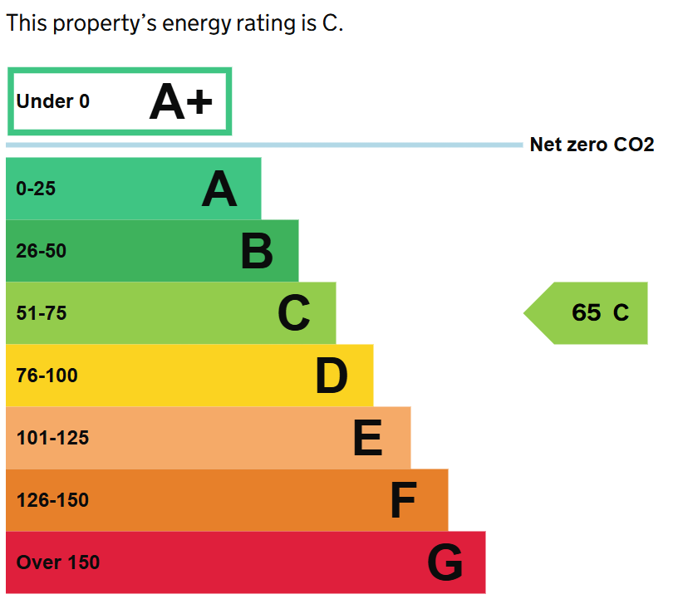
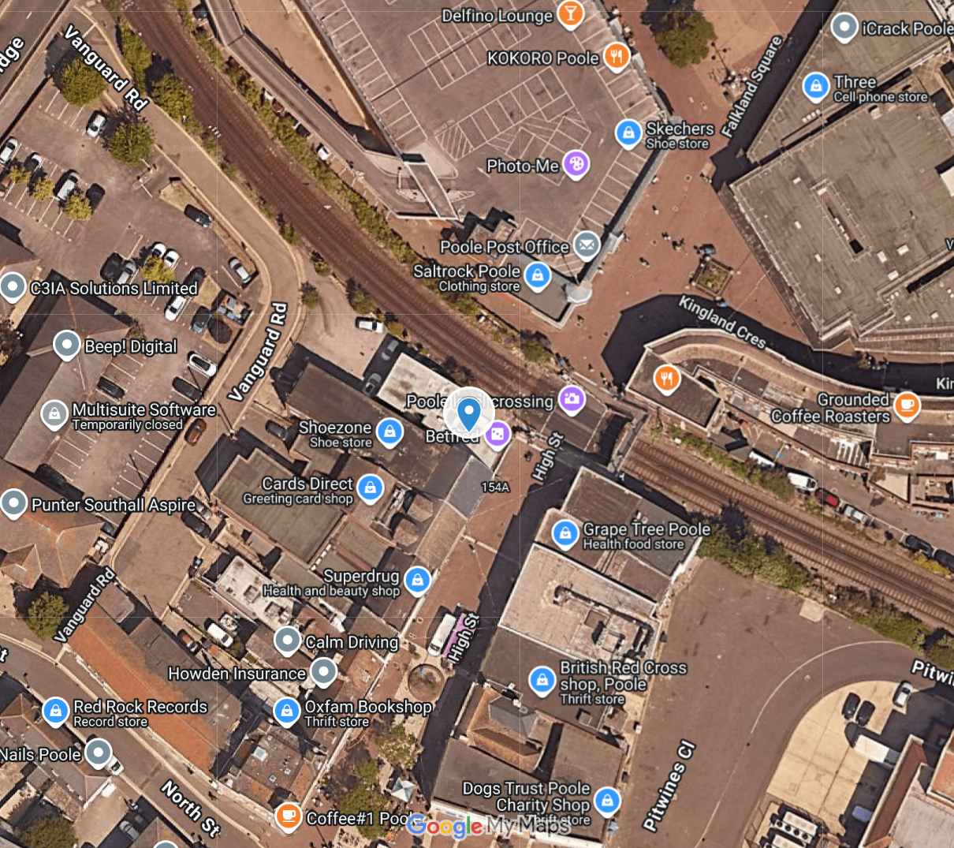
PLANNING
The property has previously been used as offices (within planning Class E). Interested parties are advised to check with BCP council as to their proposed use.
RATING
The property is listed on the Valuation Office Agency website with a Rateable Value of £18,500 (April 2026).
More details can be found at: https://www.tax.service.gov.uk/business-rates-find/valuations/start/116800172
Interested parties should make enquiries of the local authority to verify the business rates
payable.
EPC
Band C
More details can be found at: https://find-energy-certificate.service.gov.uk/energy-certificate/7445-5433-2781-3490-9941
LEASE
New full repairing and insuring lease to be granted incorporating three-yearly rent reviews.
RENT
£17,500 per annum exclusive.
Call us on 01202 673131 Visit www.jamesandsons.co.uk

Slide 4
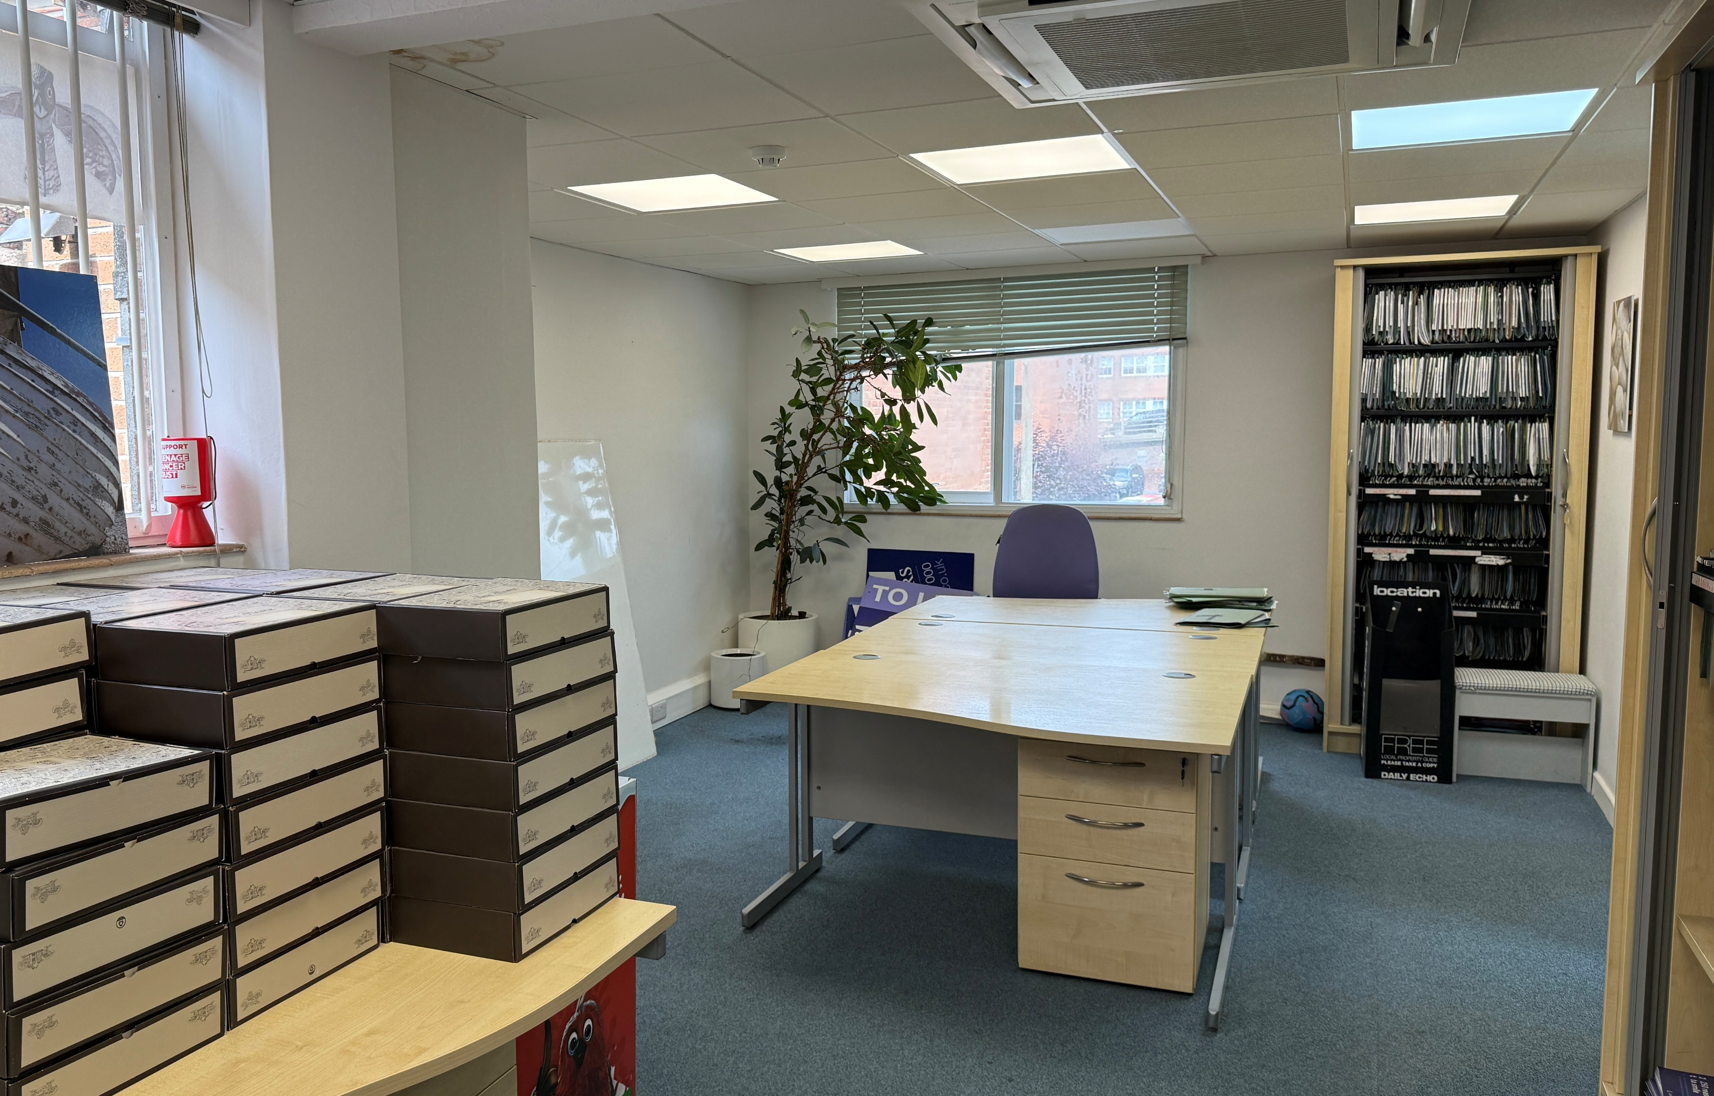
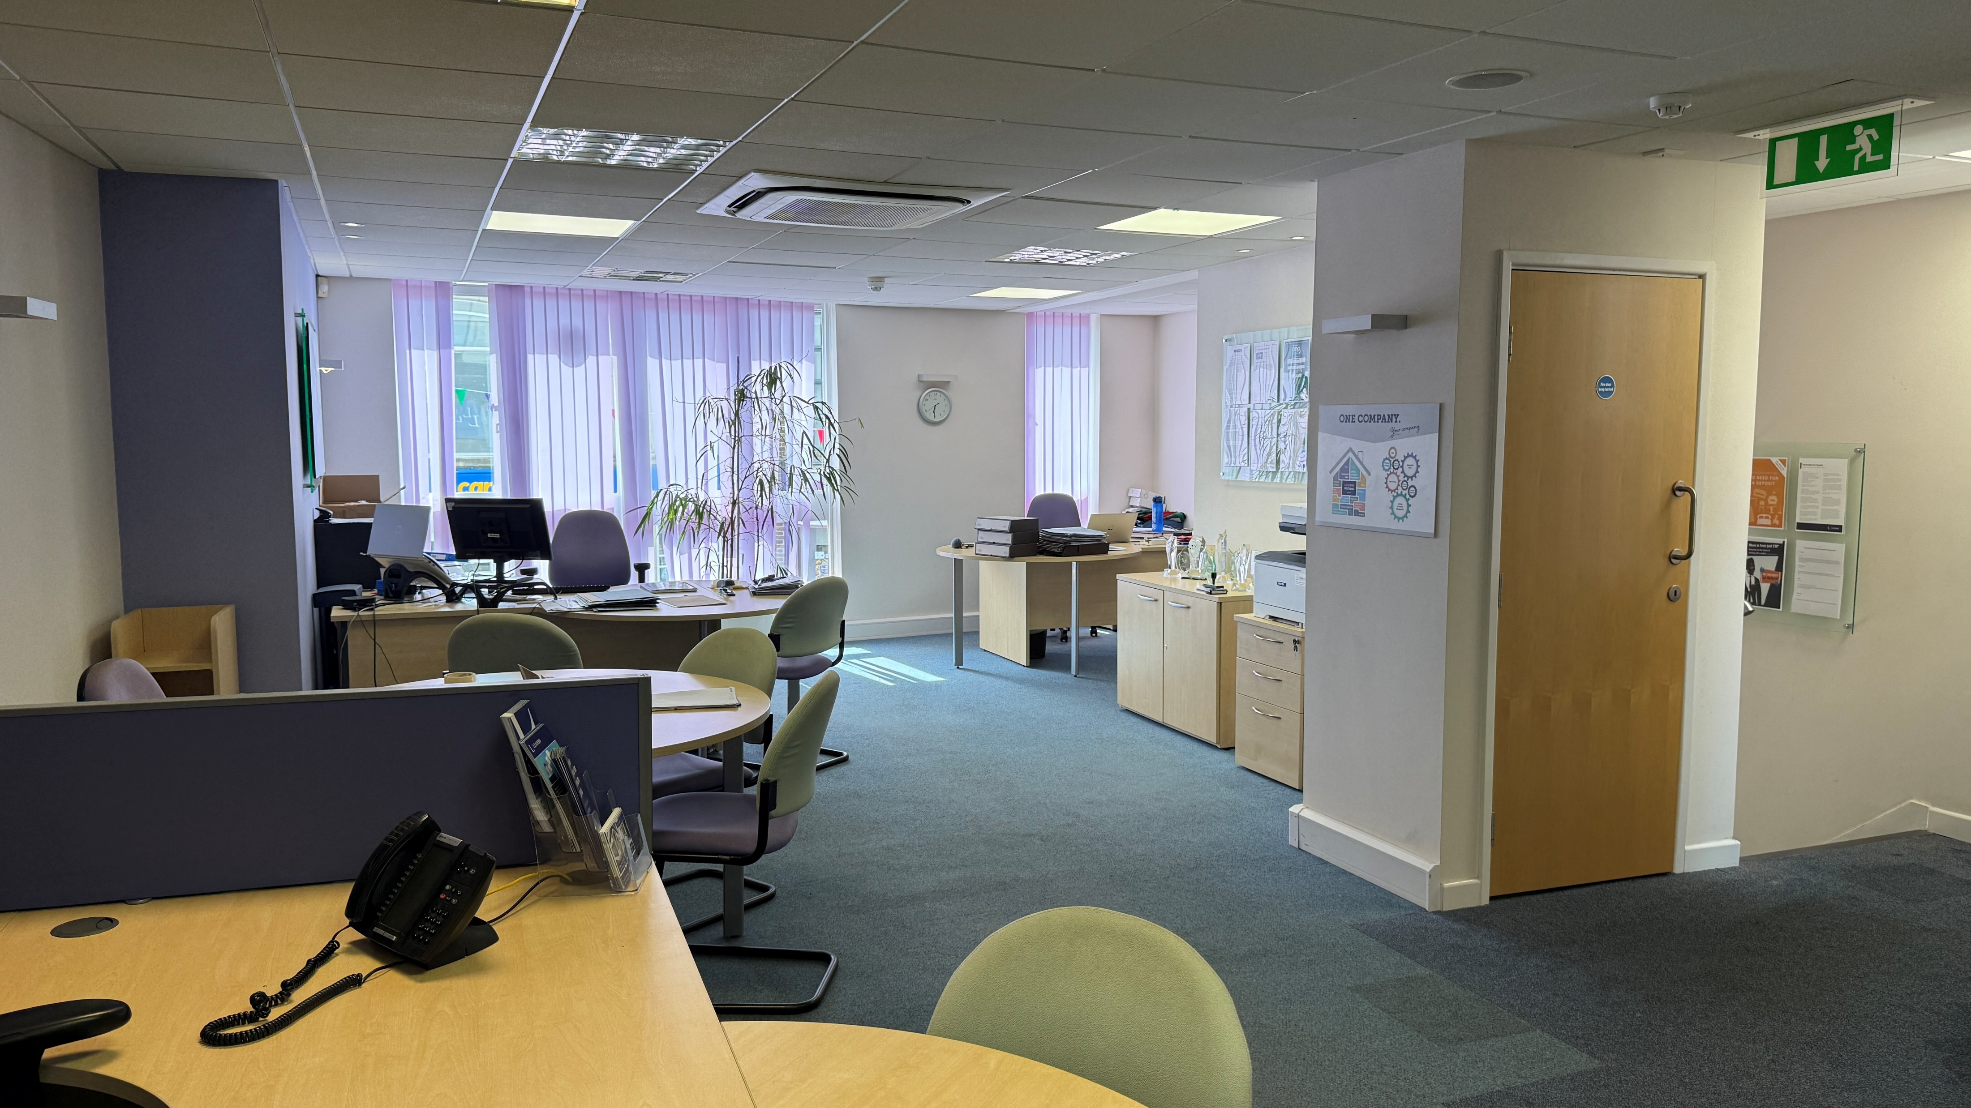
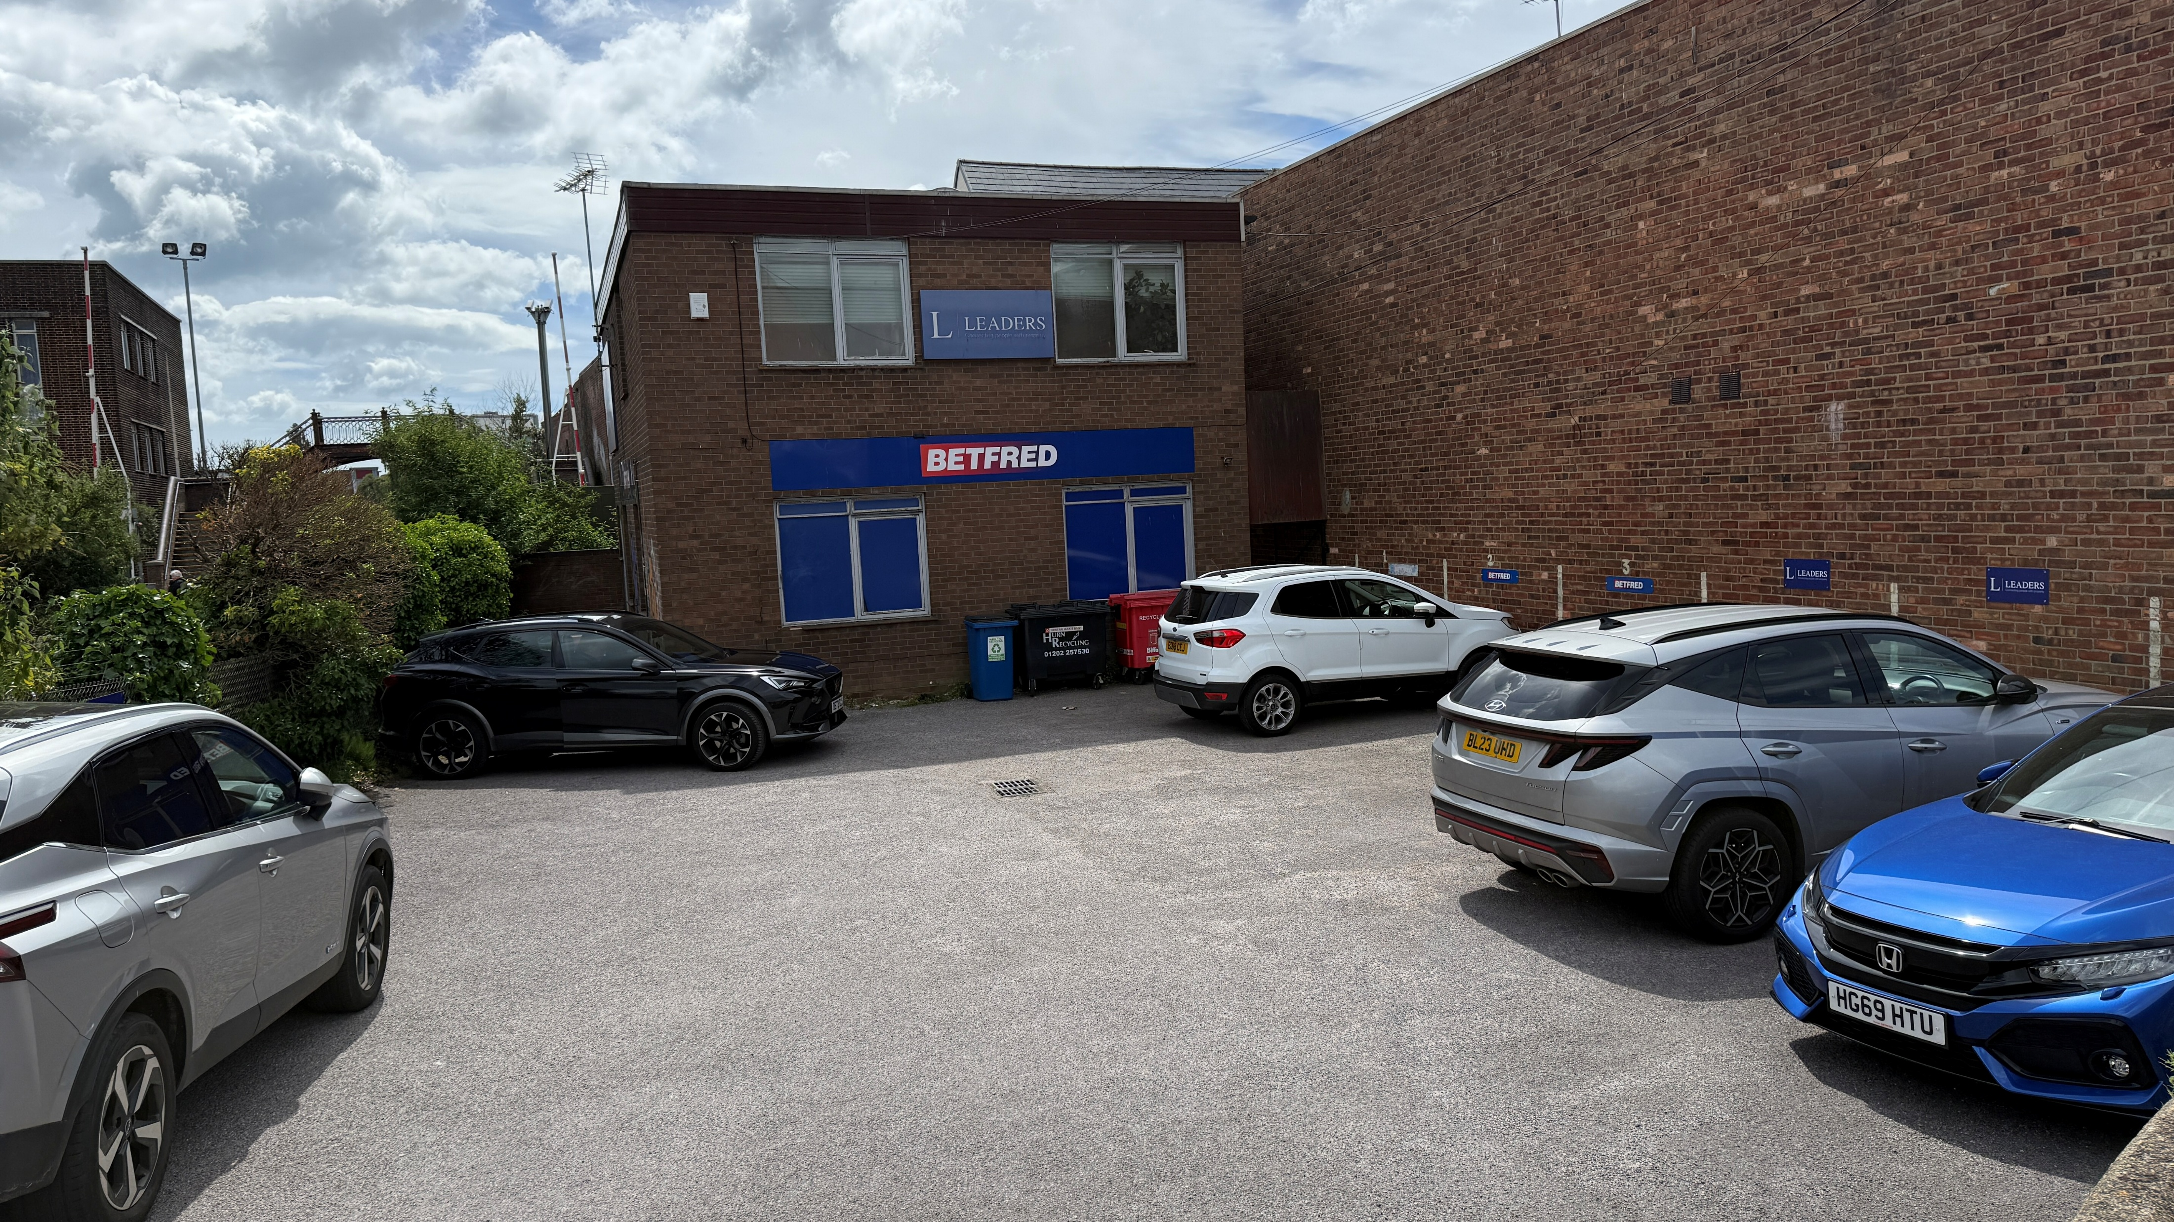
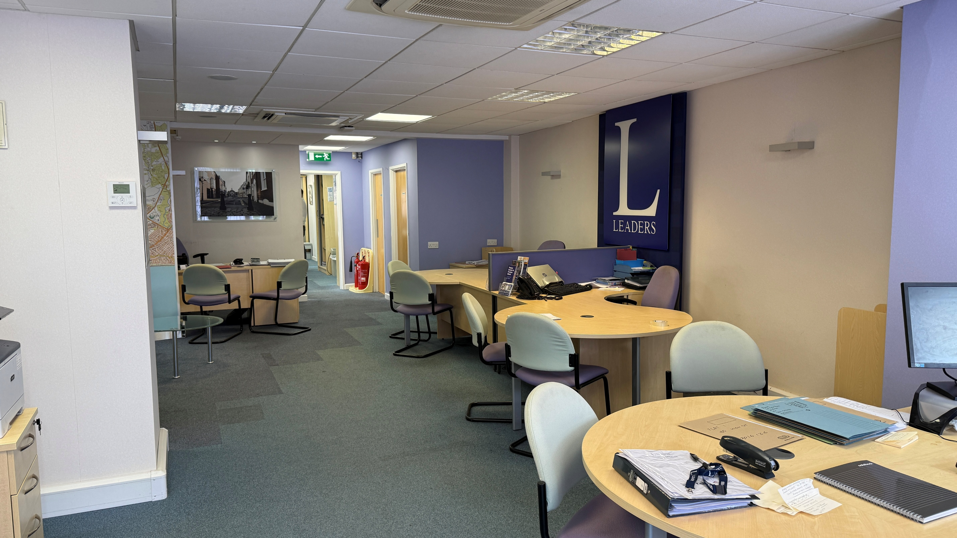
Call us on 01202 673131 Visit www.jamesandsons.co.uk

Slide 5
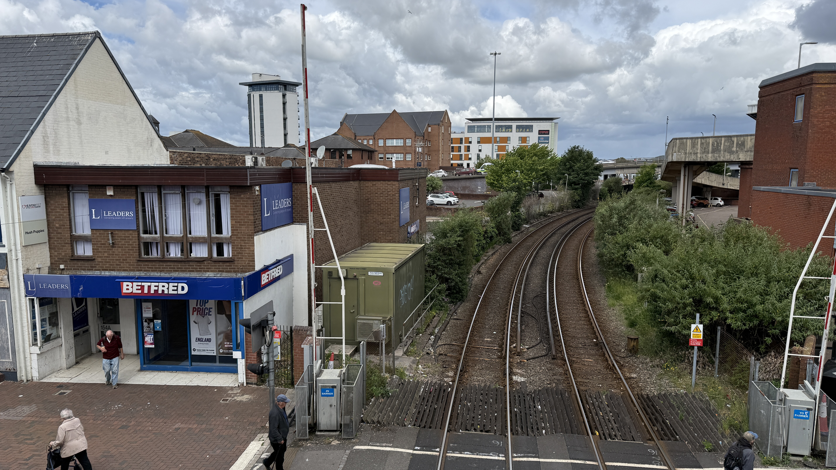
Call us on 01202 673131 Visit www.jamesandsons.co.uk

Slide 6
LEGAL COSTS
Each party to pay their own legal fees incurred in the transaction.
FINANCE ACT 1989
Unless otherwise stated, all prices and rents are quoted exclusive of Value Added Tax (VAT).
Any intending purchasers or lessees must satisfy themselves independently as to the
incidence of VAT in respect of any transaction.
CODE FOR LEASING BUSINESS PREMISES
Applicants looking to lease a business premises through James and Sons are advised of the
existence of the RICS Code for leasing business premises. Furthermore, we recommend that
all applicants obtain professional advice from an independent RICS member or other property
professional.
IDENTIFICATION
Under Money Laundering Regulations, we are obliged to verify the identity of a proposed Tenant
prior to instructing solicitors. This is to help combat fraud and money laundering and the
requirements are contained in statute. A letter will be sent to the proposed tenant once terms have
been agreed.
VIEWING
STRICTLY by appointment through James & Sons contact:
Simon Walsham
Tel: 01202 673131
Email simonwalsham@jamesandsons.co.uk
Peter Davy
Tel: 01202 673131
Email peterdavy@jamesandsons.co.uk
IMPORTANT NOTE
THESE` PROPERTY PARTICULARS ARE INTENDED AS GENERAL GUIDANCE FOR PROSPECTIVE
LESSEES OR PURCHASERS. THEY DO NOT CONSTITUTE ALL OR ANY PART OF AN OFFER OR
CONTRACT. JAMES AND SONS, EITHER FOR THEMSELVES OR AS AGENTS ON BEHALF OF THE
LESSOR OR VENDOR GIVE NO WARRANTY AS TO THE ACCURACY OF ANY OF THE
INFORMATION CONTAINED HEREIN.
ALL DESCRIPTIONS, MEASUREMENTS, REFERENCES TO CONDITION AND STATEMENTS AS TO PLANNING USE AND PERMISSIONS OR OTHER MATTER CONTAINED IN THESE PARTICULARS ARE GIVEN IN GOOD FAITH AND ARE BELIEVED TO BE CORRECT BUT THEIR ACCURACY IS NOT GUARANTEED AND SHOULD NOT BE RELIED UPON AS FACT WITHOUT INDEPENDENT VERIFICATION. NO PERSON IN THE EMPLOYMENT OF JAMES AND SONS HAS ANY AUTHORITY TO MAKE ANY REPRESENTATIONS OR WARRANTY (VERBAL OR OTHERWISE) IN RESPECT OF THIS PROPERTY AND ANY INTENDING LESSEE(S) OR PURCHASER(S) SOULD MAKE THEIR OWN INDEPENDENT ENQUIRY AND INVESTIGATIONS AND INSPECTIONS TO VERIFY THE ACCURACY OR OTHERWISE OF ANY INFORMATION.
AT NO TIME HAS ANY STRUCTURAL OR OTHER SURVEY BEEN CARRIED OUT AND NO SERVICES OR APPLIANCES HAVE BEEN TESTED. INTERESTED PARTIES SHOULD SATISFY THEMSELVES AS TO THE STRUCTURAL INTEGRITY OF THE PROPERTY AND THE CONDITION AND WORKING ORDER OF ALL SERVICES, APPLIANCES, FIXTURES AND FITTINGS.
PEOPLE AND PROPERTY SINCE 1873
Call us on 01202 673131 Visit www.jamesandsons.co.uk

